Slide 1
OTP Transit Index and TriMet
Data and functional gaps in the
Transit Index regarding TriMet data
November 2016

Slide 2
issue #1: current stops
Things to look at:
On ride.trimet.org stops are only shown that are currently active
Look at the circles between this page and the next, and notice how many more stops show up on call.trimet.org

Slide 3
issue #1: current stops
Things to look at:
The call.trimet.org system has a stop overlay like ride.trimet.org
Problem is there's no filtering of stops that appear in TriMet's GTFS.zip file.
Often stops in the GTFS are not active at certain points in the schedule.
Determining an effective schedule period requires looking at all the trips in the GTFS, and determining which stops have service … for this reason, we choose to go the gtfsdb route for our pages

Slide 4
issue #1: current stops
Things to look at:
The stop in call.trimet.org looks like a normal stop, and shows information like it was an active open stop.
Only by planning a trip from the stop do we get some hint that the stop is not active.

Slide 5
issue #2: stops types
Things to look at:
On ride.trimet.org, we have 5 different icons for stops.
Here you see blue bus icons, small black streetcar stops and larger black MAX icons

Slide 6
issue #2: stops types
Things to look at:
Within the OTP transit index, there is no concept of stop (mode) type.
Thus in call.trimet.org, there's no differentiation between the different rail and bus modes servicing stops.

Slide 7
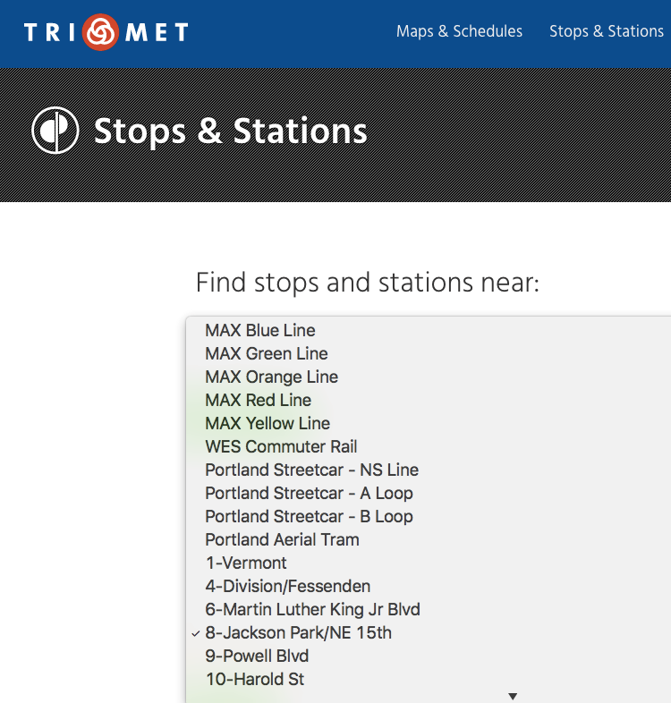
issue #3: route sort order
Things to look at:
There's a proposed extension in GTFS, where a route sort order column is added to routes.txt
TriMet supplies the route sort order, and gtfsdb reads and returns this info

Slide 8
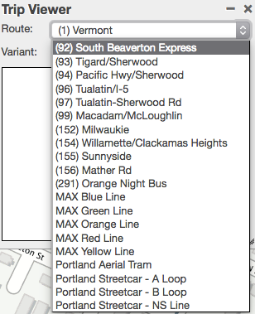
issue #3: route sort order
Things to look at:
The OTP transit index (and OBA gtfs libs) are not reading route sort order

Slide 9
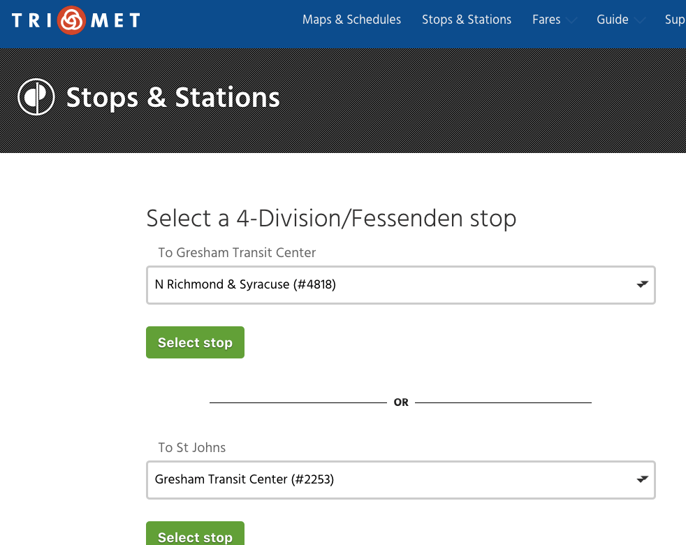
issue #4: route direction
Things to look at:
There's a proposed extension in GTFS's to add route_directions.txt
TriMet supplies route_directions.txt, and gtfsdb reads and returns this info

Slide 10
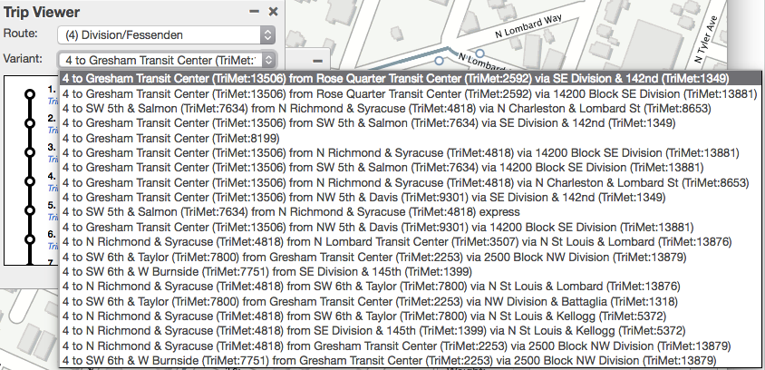
issue #4: route direction
Things to look at:
Without route_directions.txt, one alternative is to show all route patterns as variations the route may take.
Listing route patterns doesn't lend itself to a useful route pull down UI.
Use of the he GTFS extension route_directions.txt would help here.

Slide 11
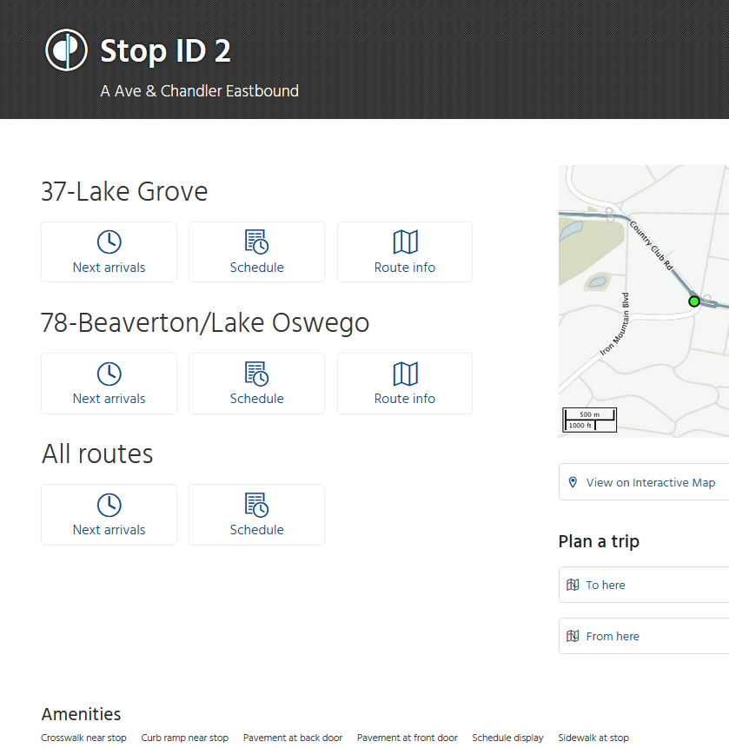
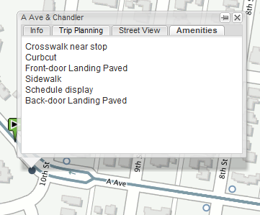
issue #5: stop amenities
Things to look at:
The current map and stop pages show stop amenities.
Yet another proposed extension to GTFS, of which GTFSDB has an implementation.

